Slide 1
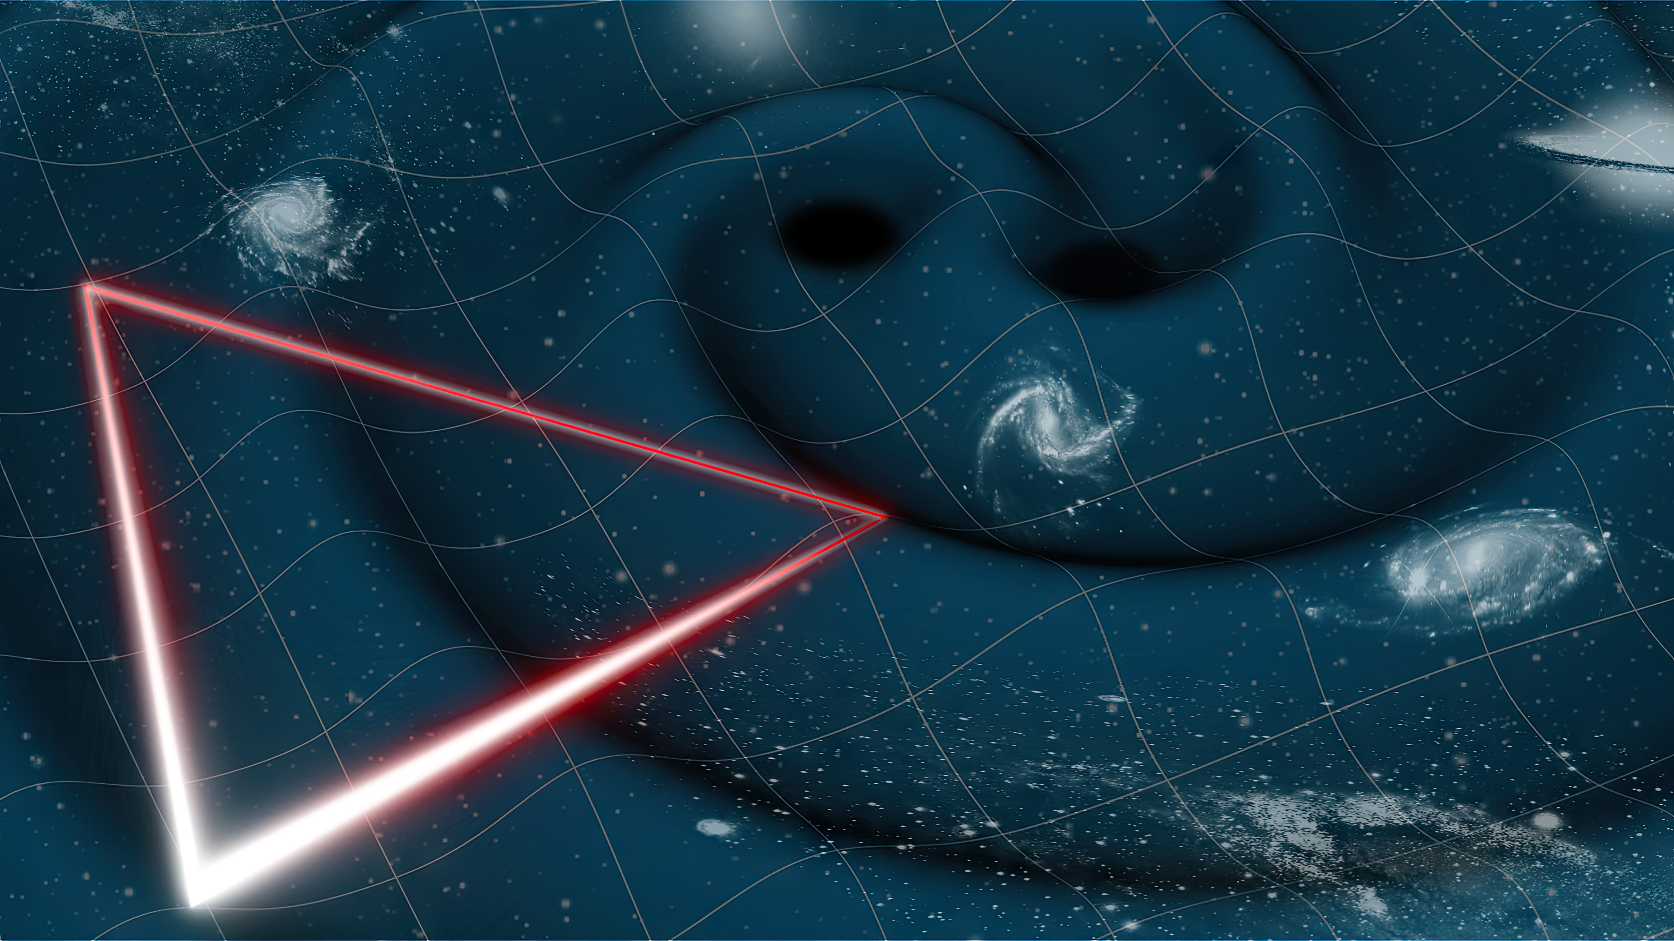
Testbed for Validating Second-Generation TDI and Clock Noise Correction for LISA
Karin Kruuse
Reid Ferguson, Daniele Vetrungo, Guido Müller
Notes:
Date. Change
Add event, location, student seminar intro talk

Slide 2
Outline of the Talk
LISA interferometry
About previous LISA simulators
Overview of our proposed LISA testbed
Its purpose and goals
Status of the current purely electronic testbed
Putting together an optical input
Notes:
studying the realistic clock noise pipeline

Slide 3
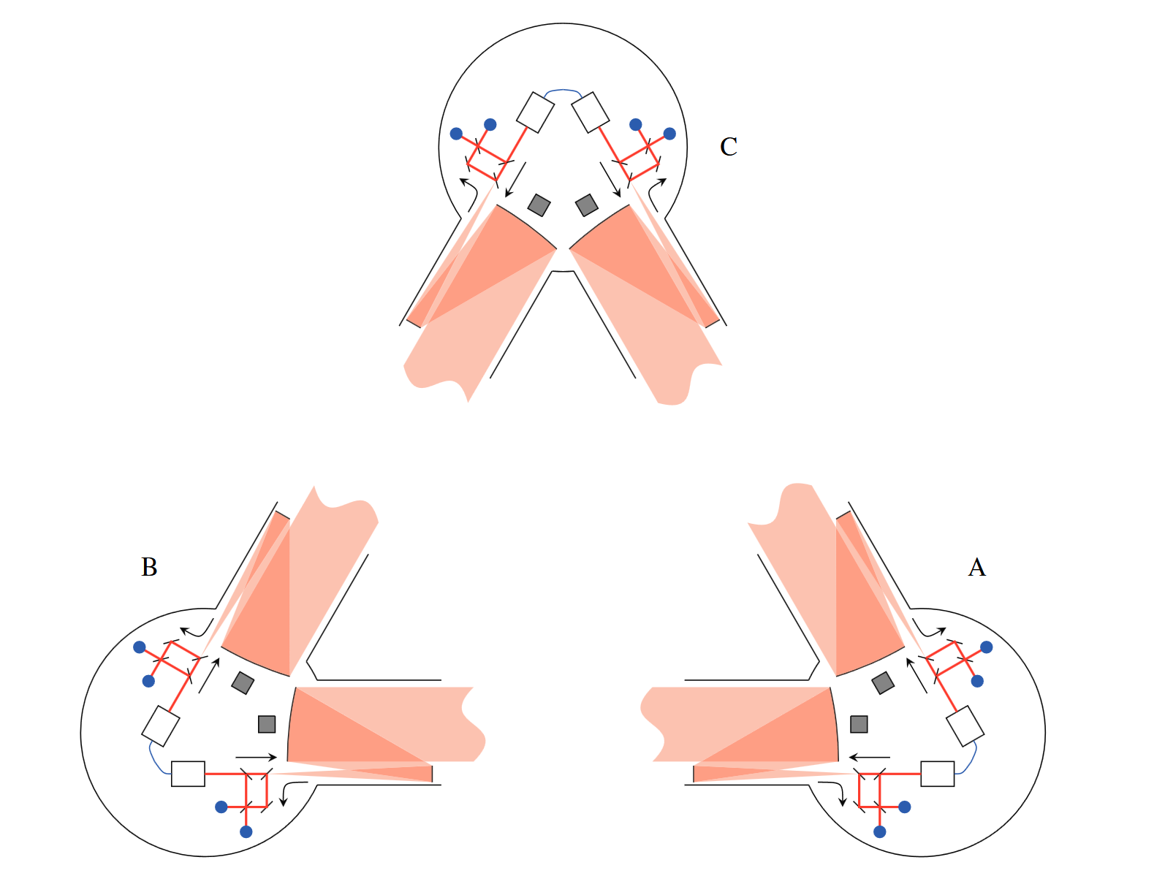
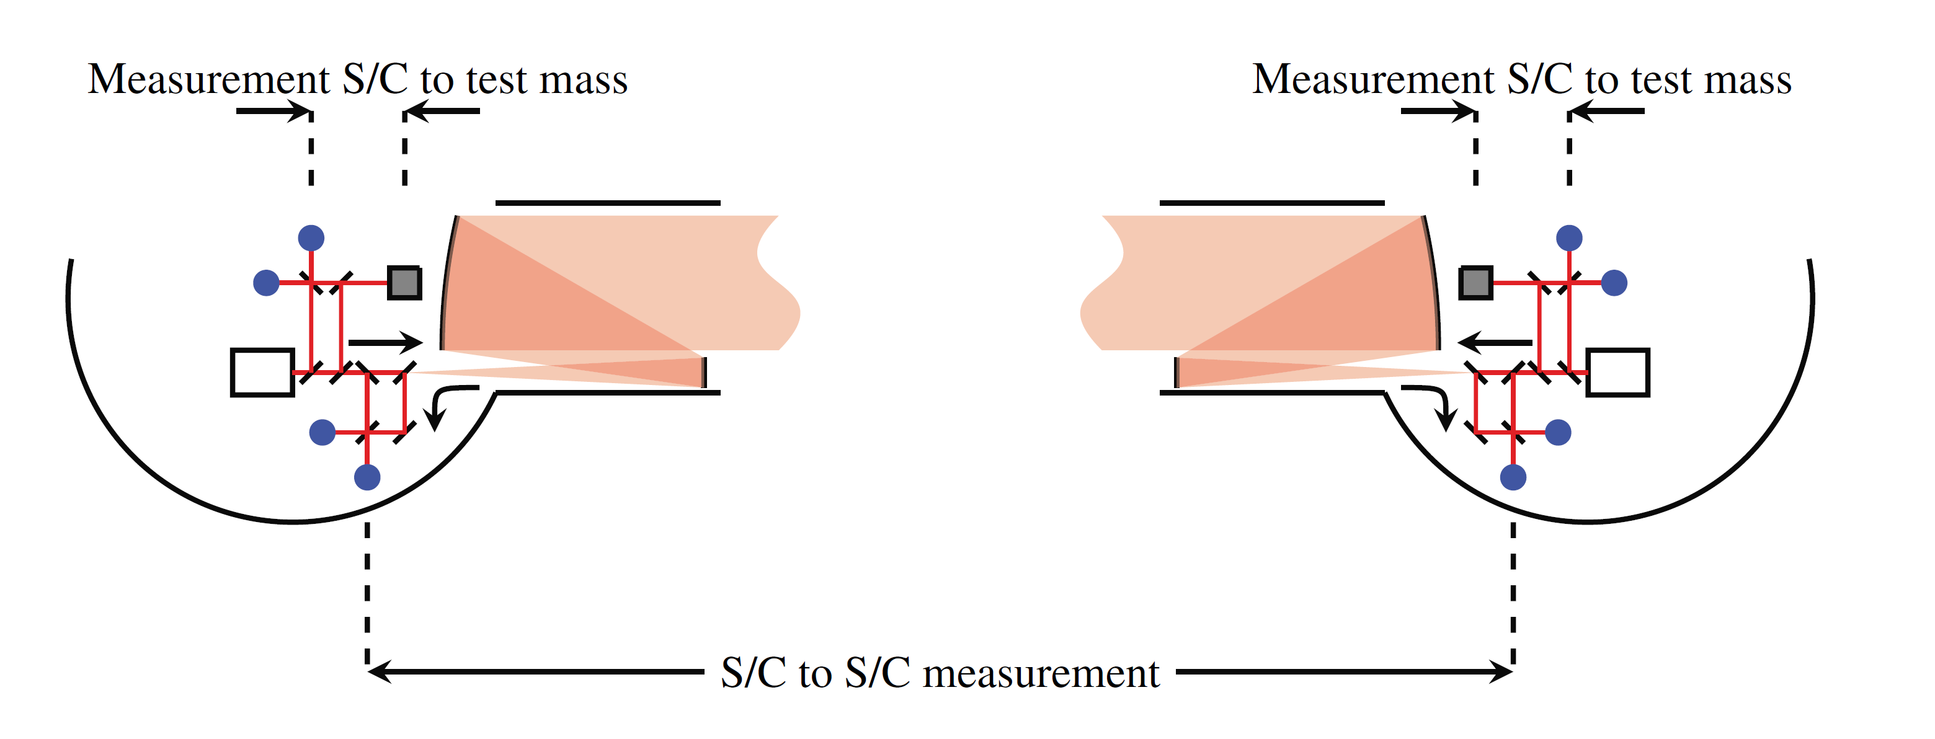
The Satellites
Three satellites surrounding six test masses in free fall
Each satellite houses two lasers, two optical benches and a phasemeter.
Each optical bench houses three interferometers.
The test mass to test mass distances are measured in three parts – this is the so-called split interferometry used in LISA.
Jennrich, 2010
Notes:
Maybe just bullet points/ or just read only if that helps with nerves

Slide 4
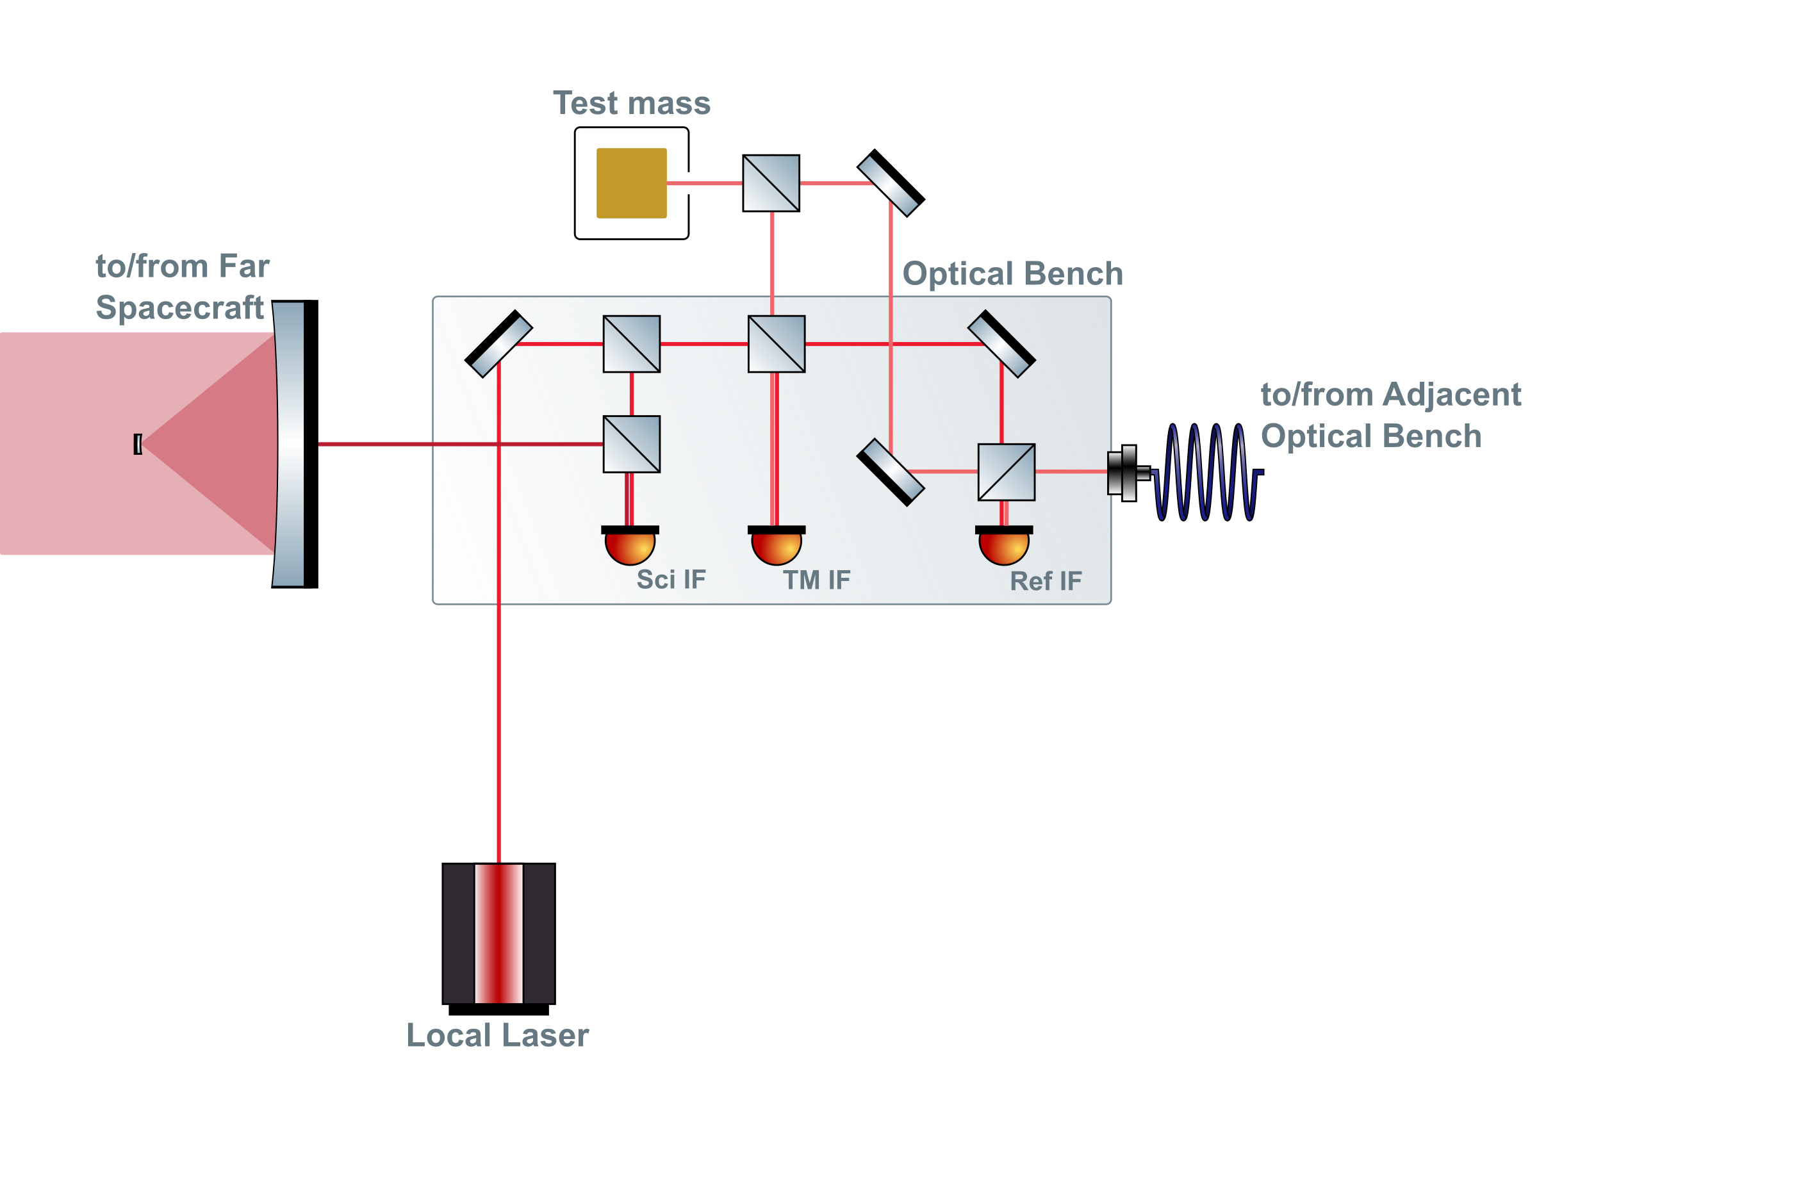
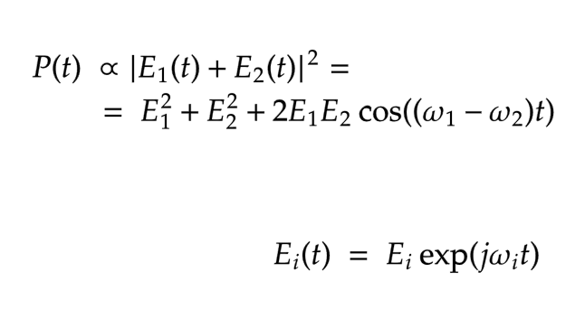
Internals of a LISA Spacecraft
LISA interferometric metrology system
heterodyne interferometry
Notes:
UGLY

Slide 5
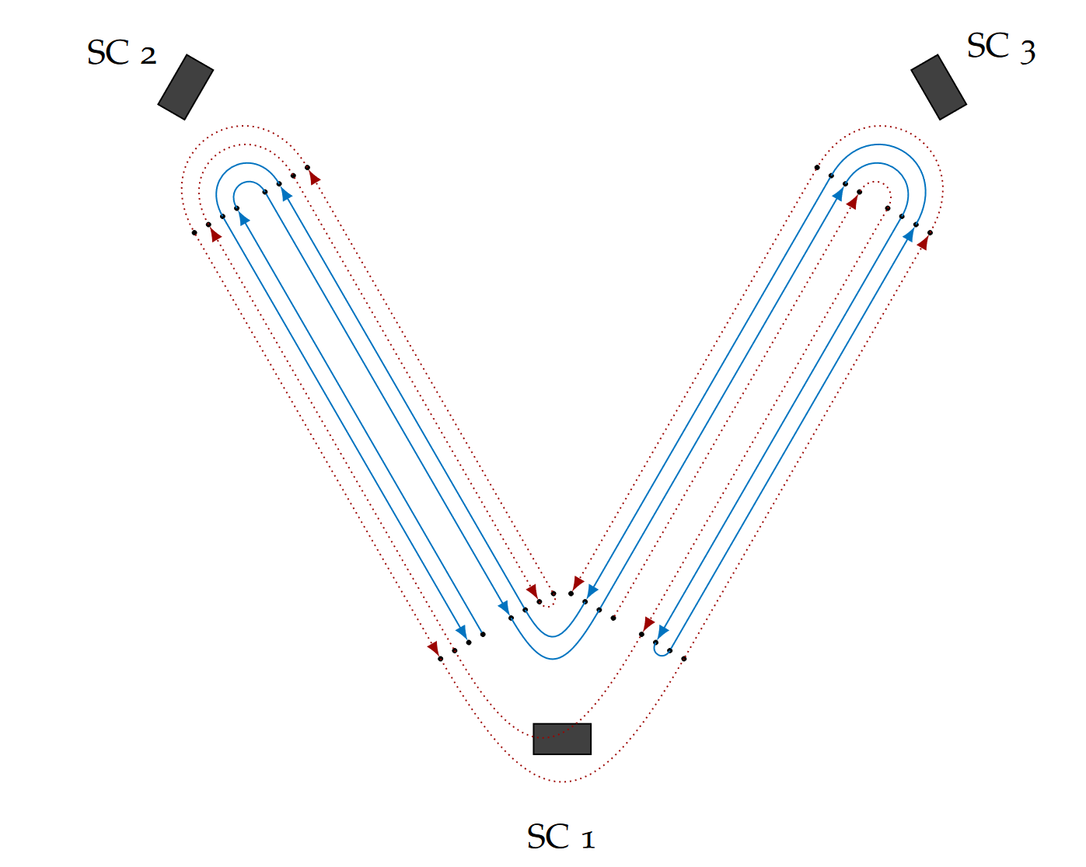
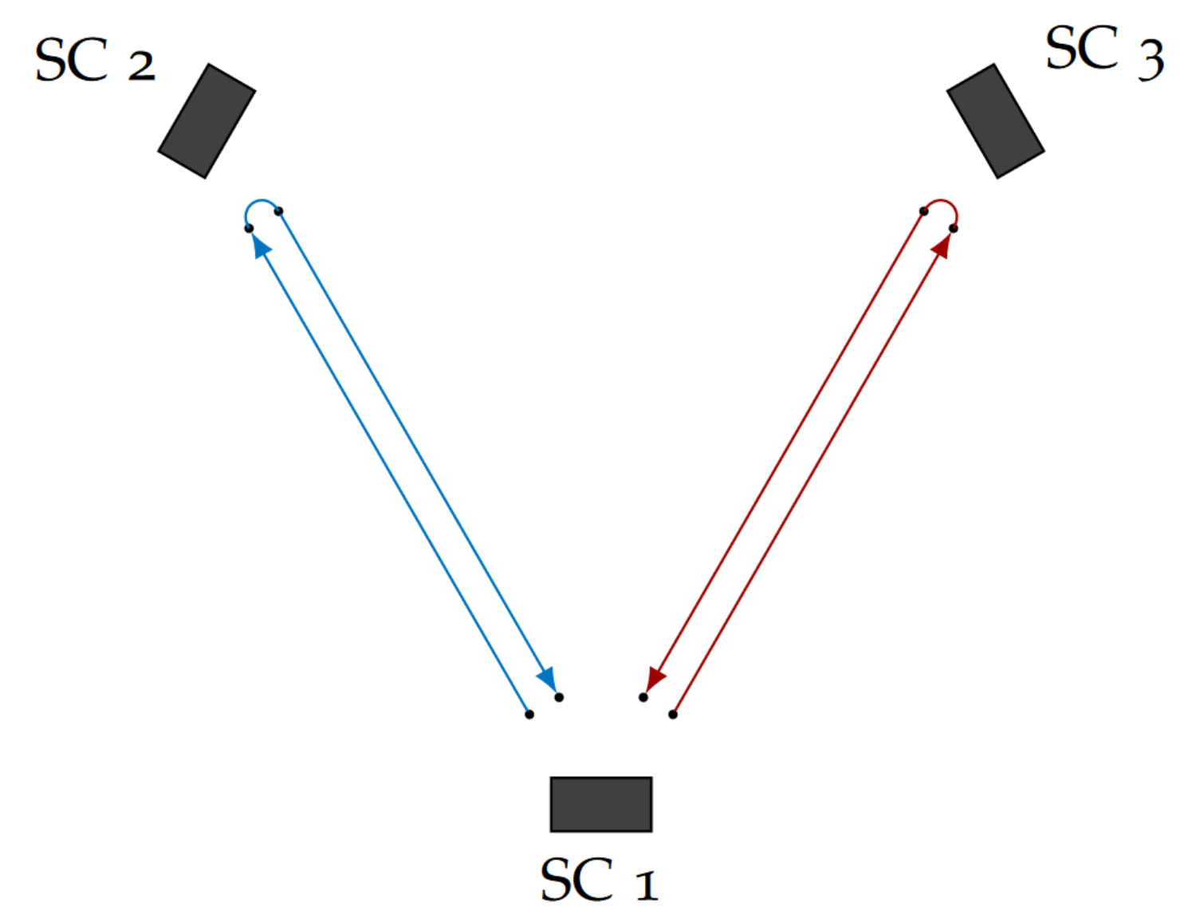
Laser Noise Reduction via TDI
Time Delay Interferometry (TDI) is a cluster of methods to construct virtual equal arms in post-processing.
0th generation TDI X combination, equal unchanging arm lengths
In practice, 2nd generation combinations should suppress noise enough to meet the requirement.
Hartwig, 2021

Slide 6
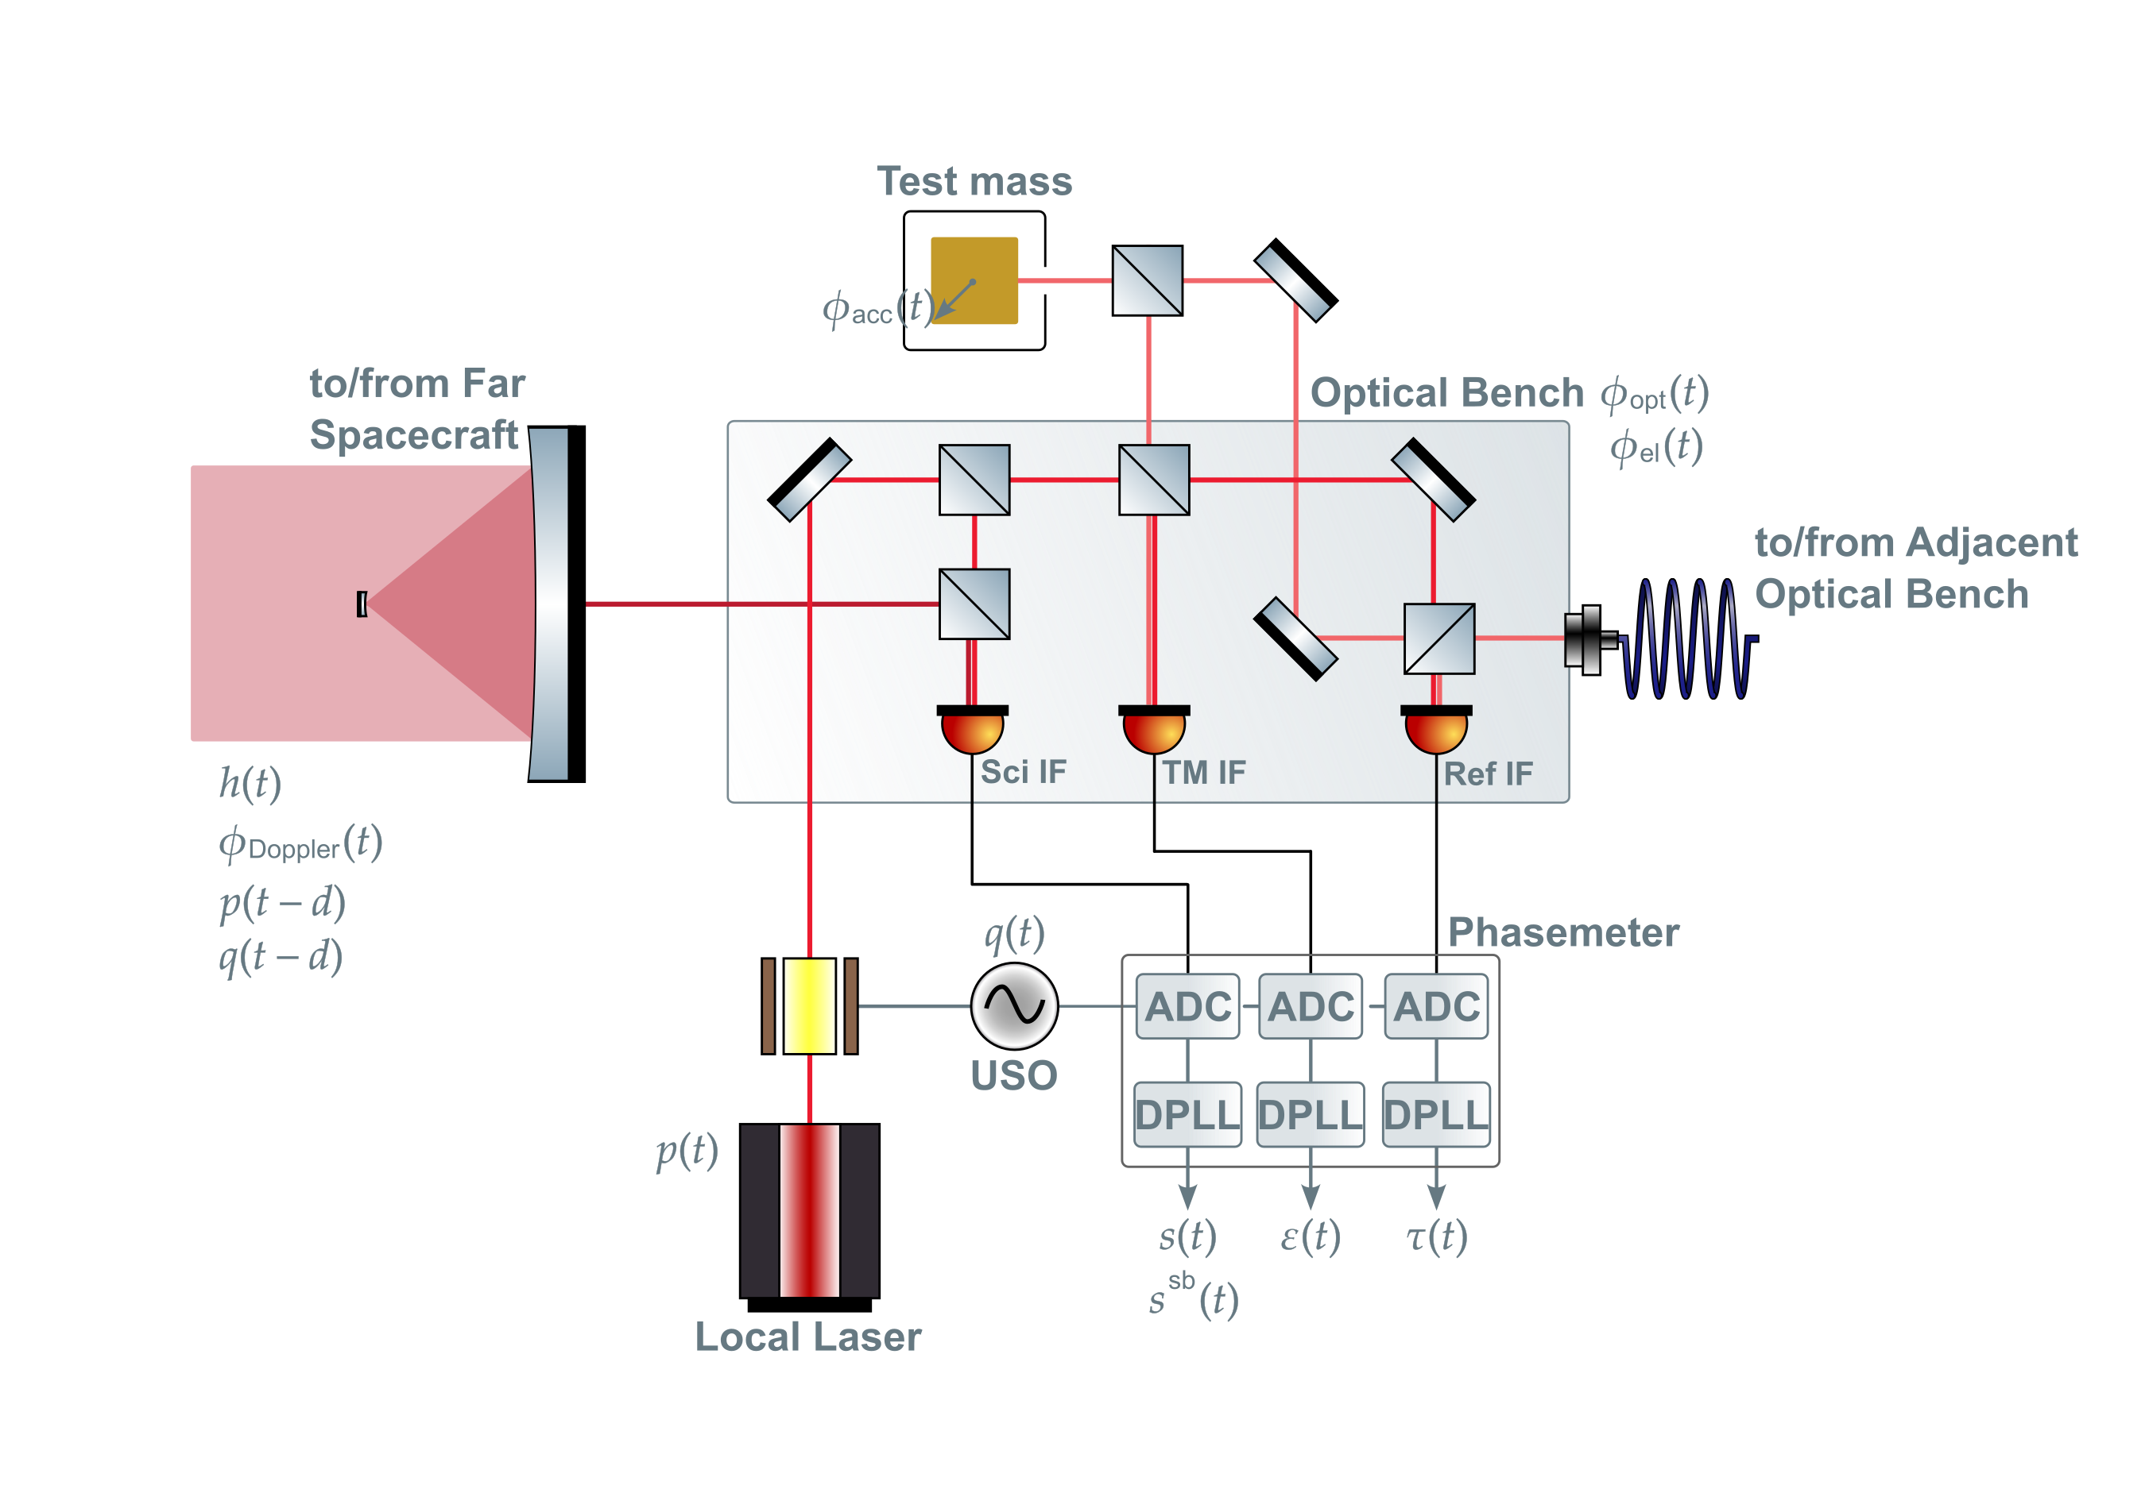
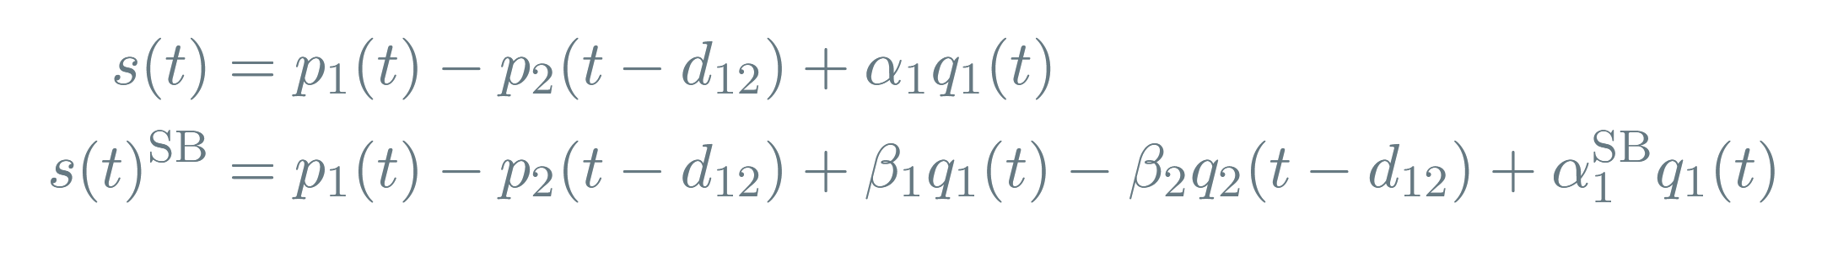
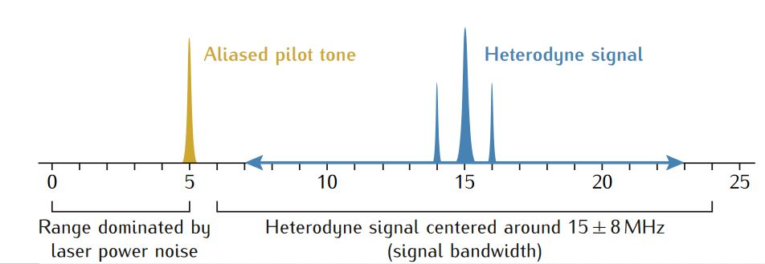
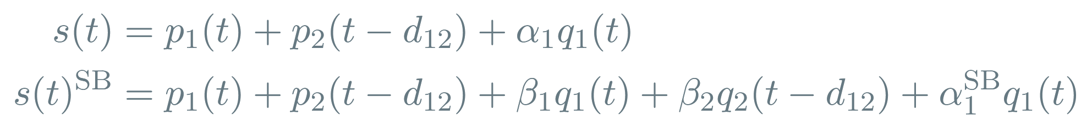
Clock Noise Reduction
After demodulation, considering laser noise and clock jitter:
Lisa metrology system-final report, 2014
Notes:
FIX MATH

Slide 7
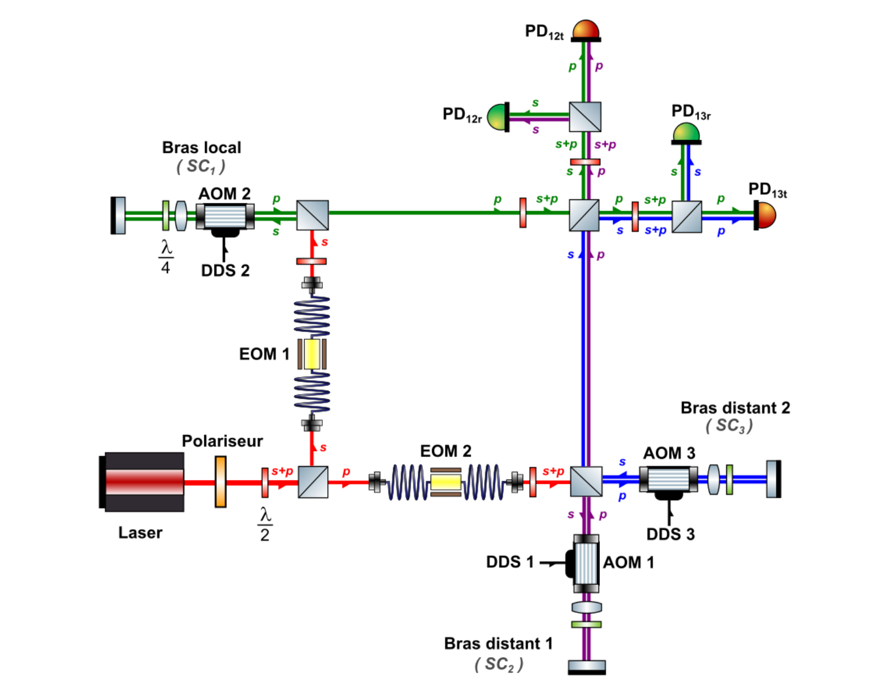
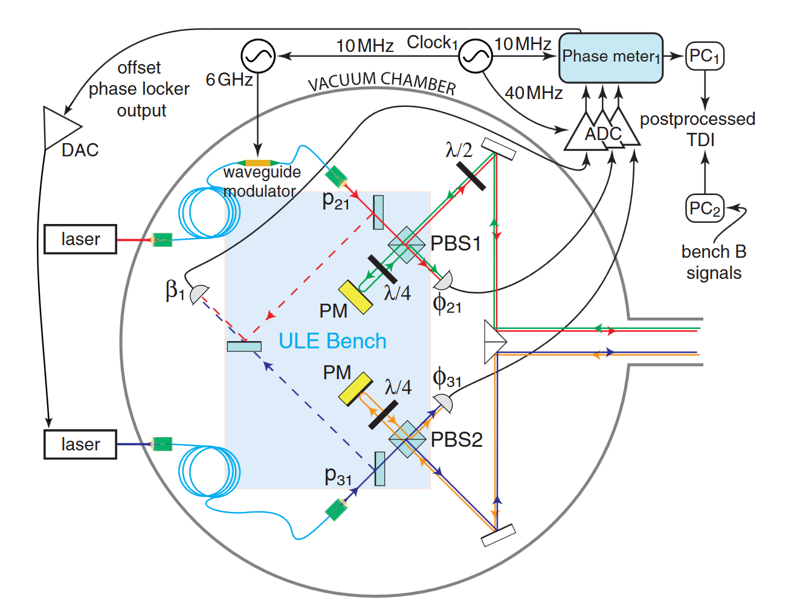
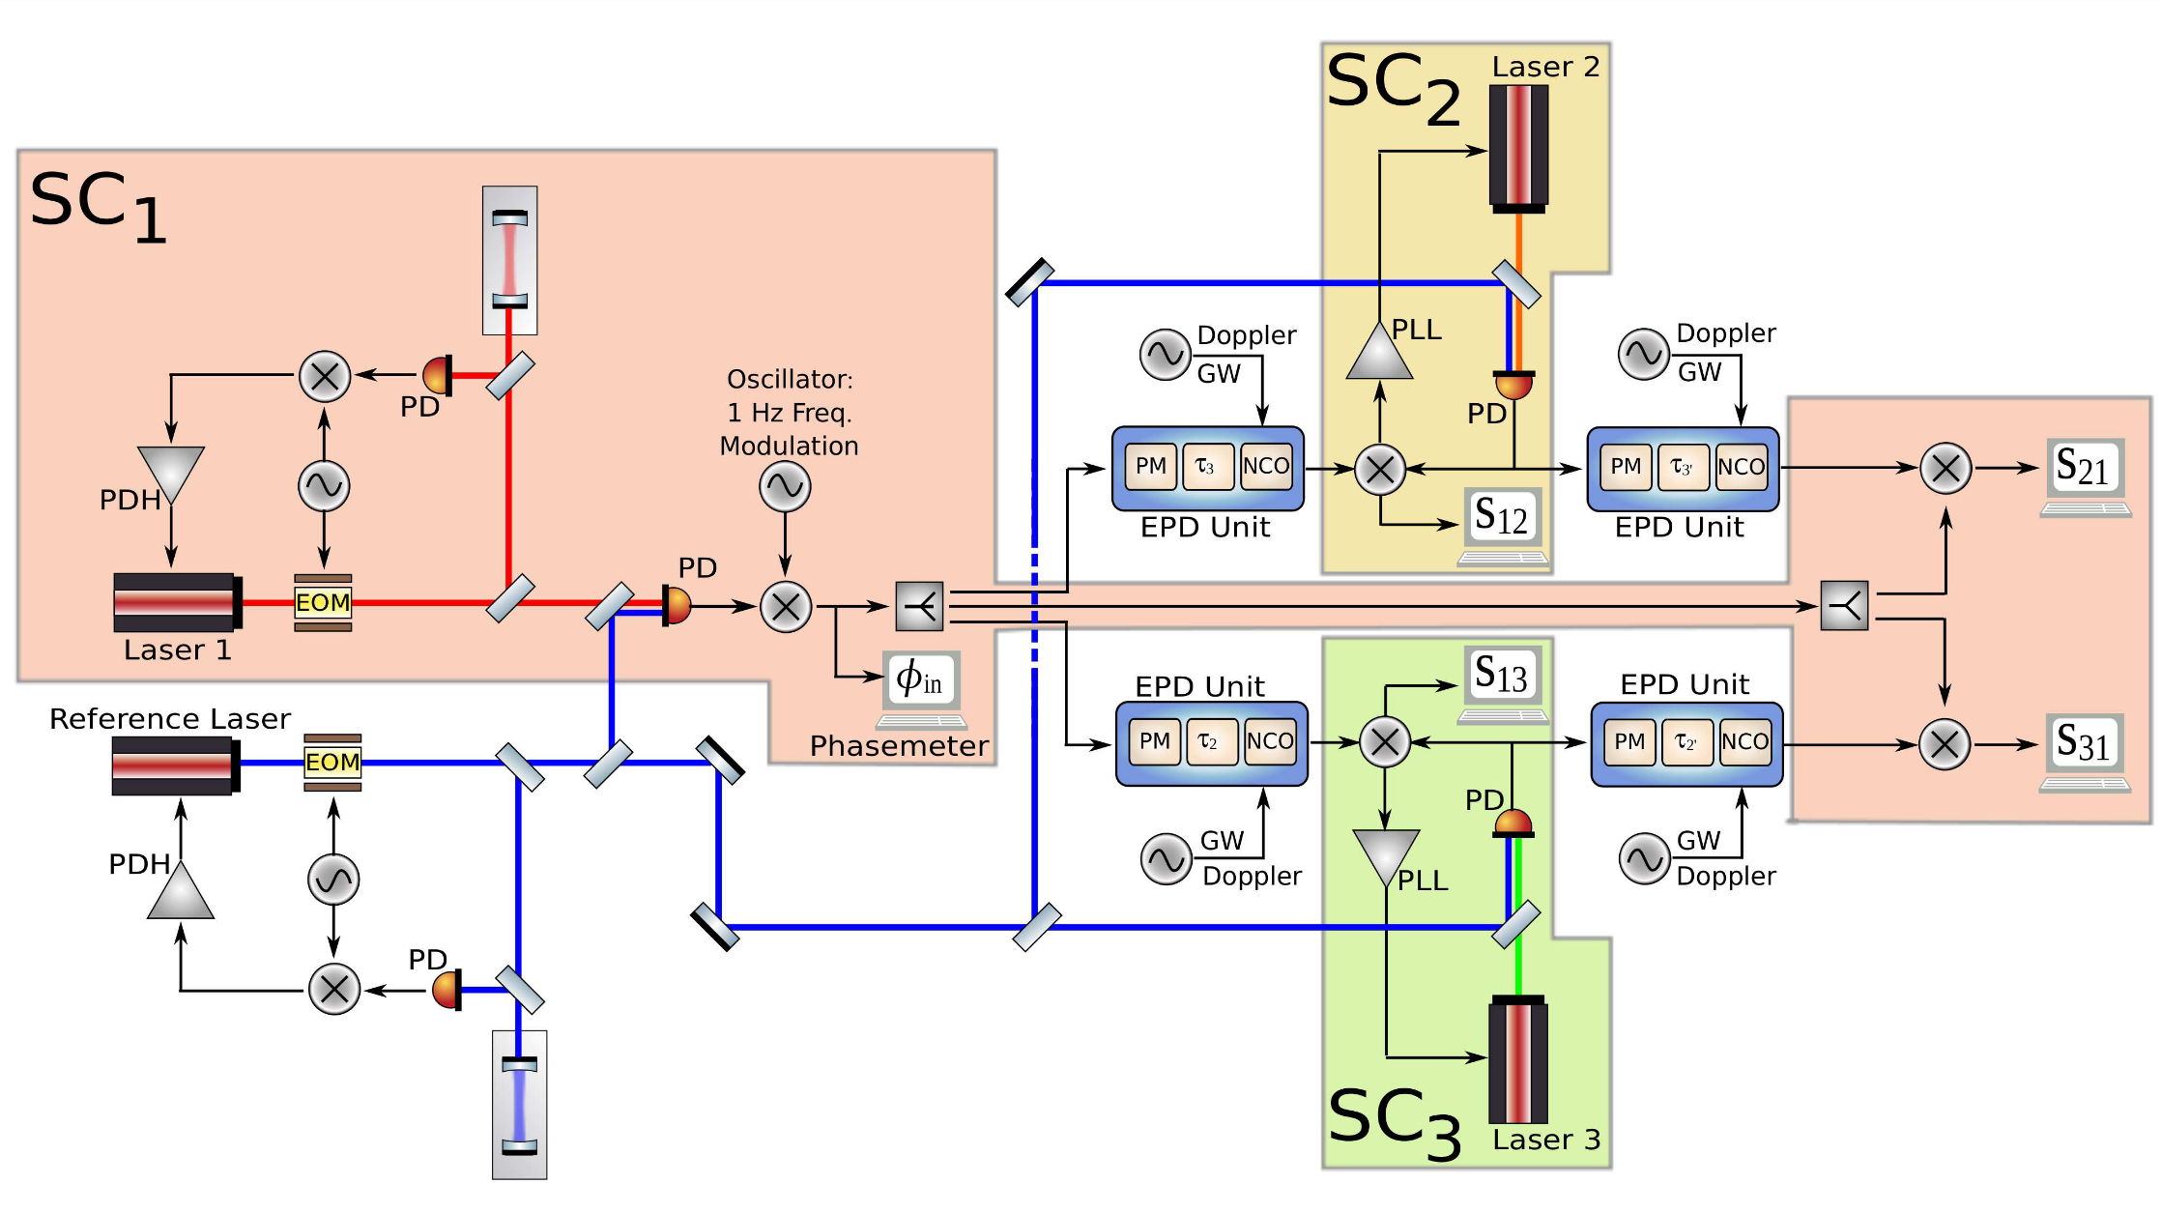
Previous Experiments
Mitryk, 2012: Laser Noise Mitigation through Time Delay Interferometry for Space-based Gravitational Wave Interferometers Using the UF Laser Interferometer
De Vine et al., 2010: Experimental Demonstration of Time-Delay Interferometry for LISA, JPL
Vidal, 2023: Validation expérimentale des performances interférométriques de LISA, Paris
Laser noise, No Clock Jitter, Realistic Delay
Laser noise, Clock jitter, No delay
Laser noise, Clock Jitter, Delay

Slide 8
MiniLISA
MiniLISA is a hardware testbed that aims to simulate LISA’s signal chain and test whether we can recover a gravitational wave signal from a realistic, noisy system.
To start with, we want to test the combination of second generation TDI and the clock noise removal post-processing methods on experimental data.
MiniLISA could also offer a substitute to modelled noise sources included in current data analysis.
Notes:
Expand on the goals more

Slide 9
Current Status
A fully electronic implementation of the interferometry system together with a delay and gravitational wave injection has already been developed and is being tested.
Time varying delays
Doppler shifts for both the carrier and sidebands
Gravitational wave injection

Slide 10
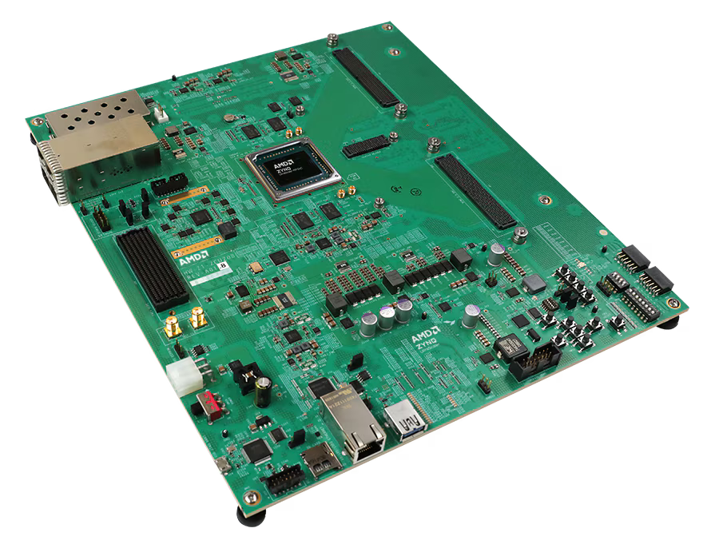
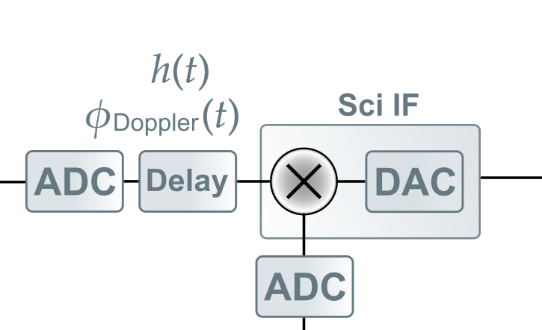
The Delay Line
The center of the experiment is the delay line.
The added varying delays, gravitational wave signals and Doppler shifts are controllable via a Python-based interface.
AMD Zynq™ UltraScale+™ RFSoC ZCU208 Evaluation Kit

Slide 11
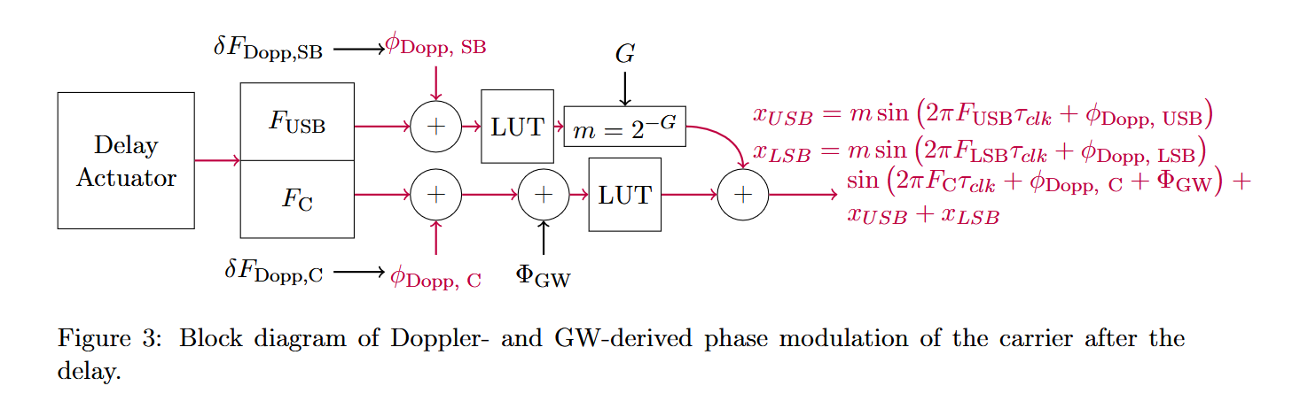
Signal Processing on the Delay Line
The evaluation board includes enough to take in two photodetector readings and output the corresponding LISA-like beatnote as an electrical signal.
Credit: Reid Ferguson

Slide 12
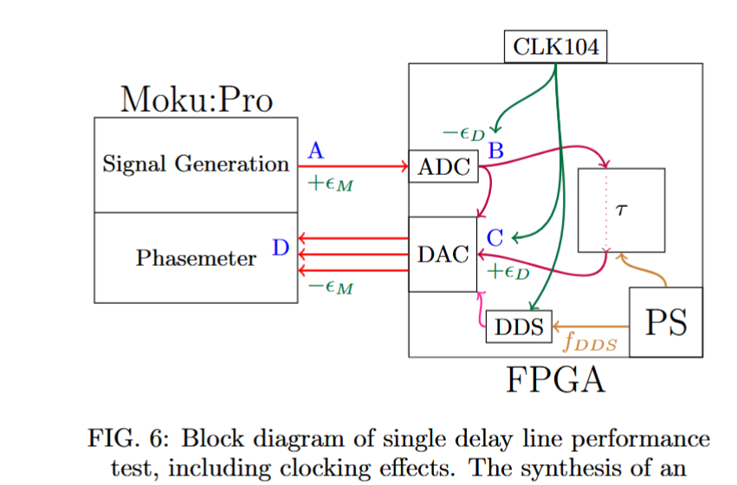
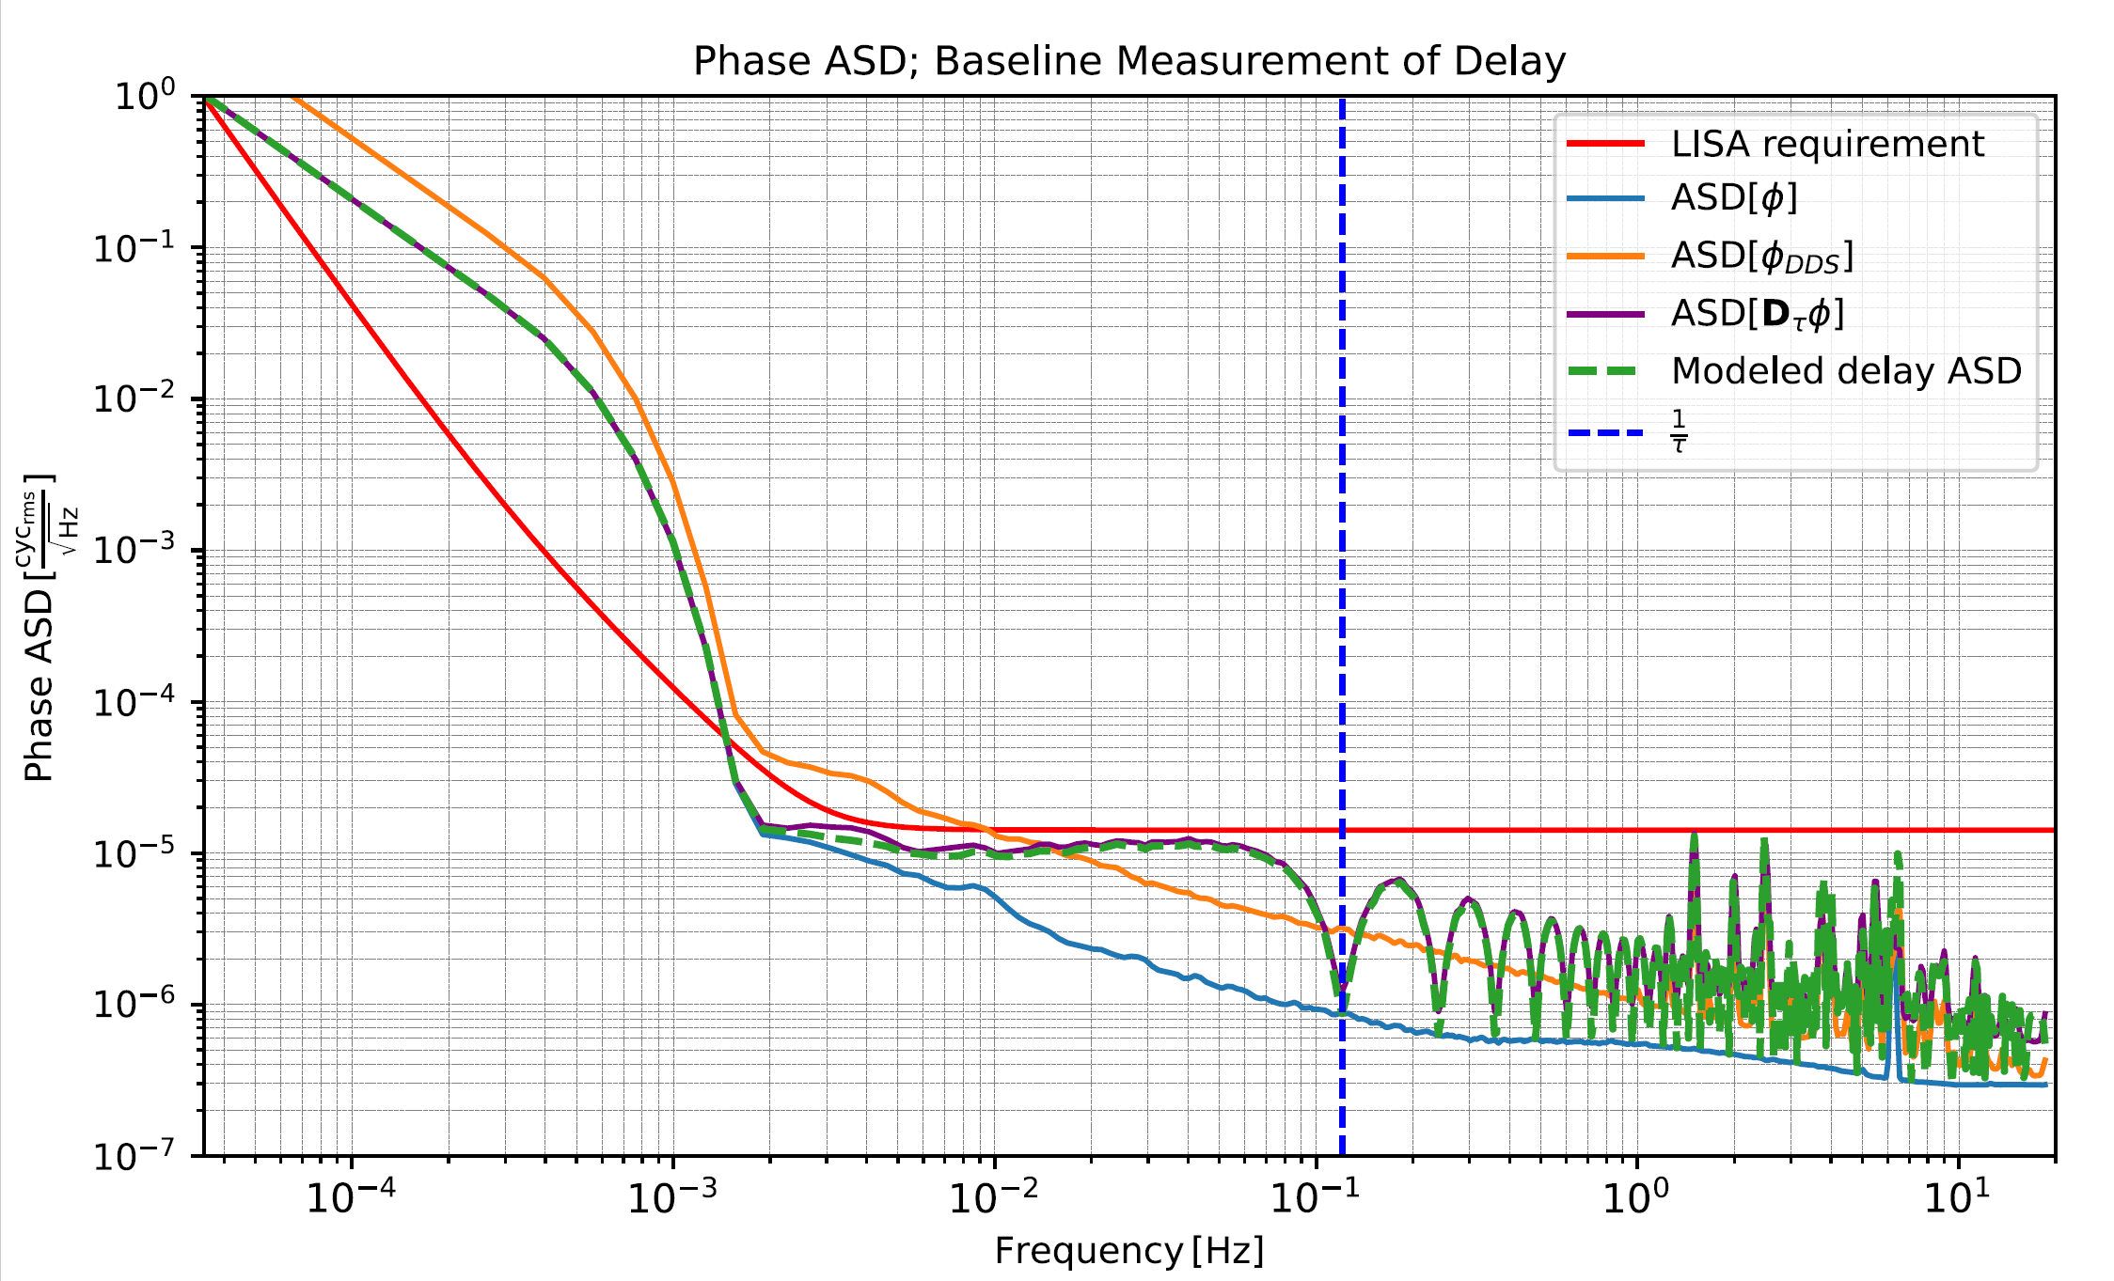
Delay Line Noise Measurement
Credit: Reid Ferguson

Slide 13
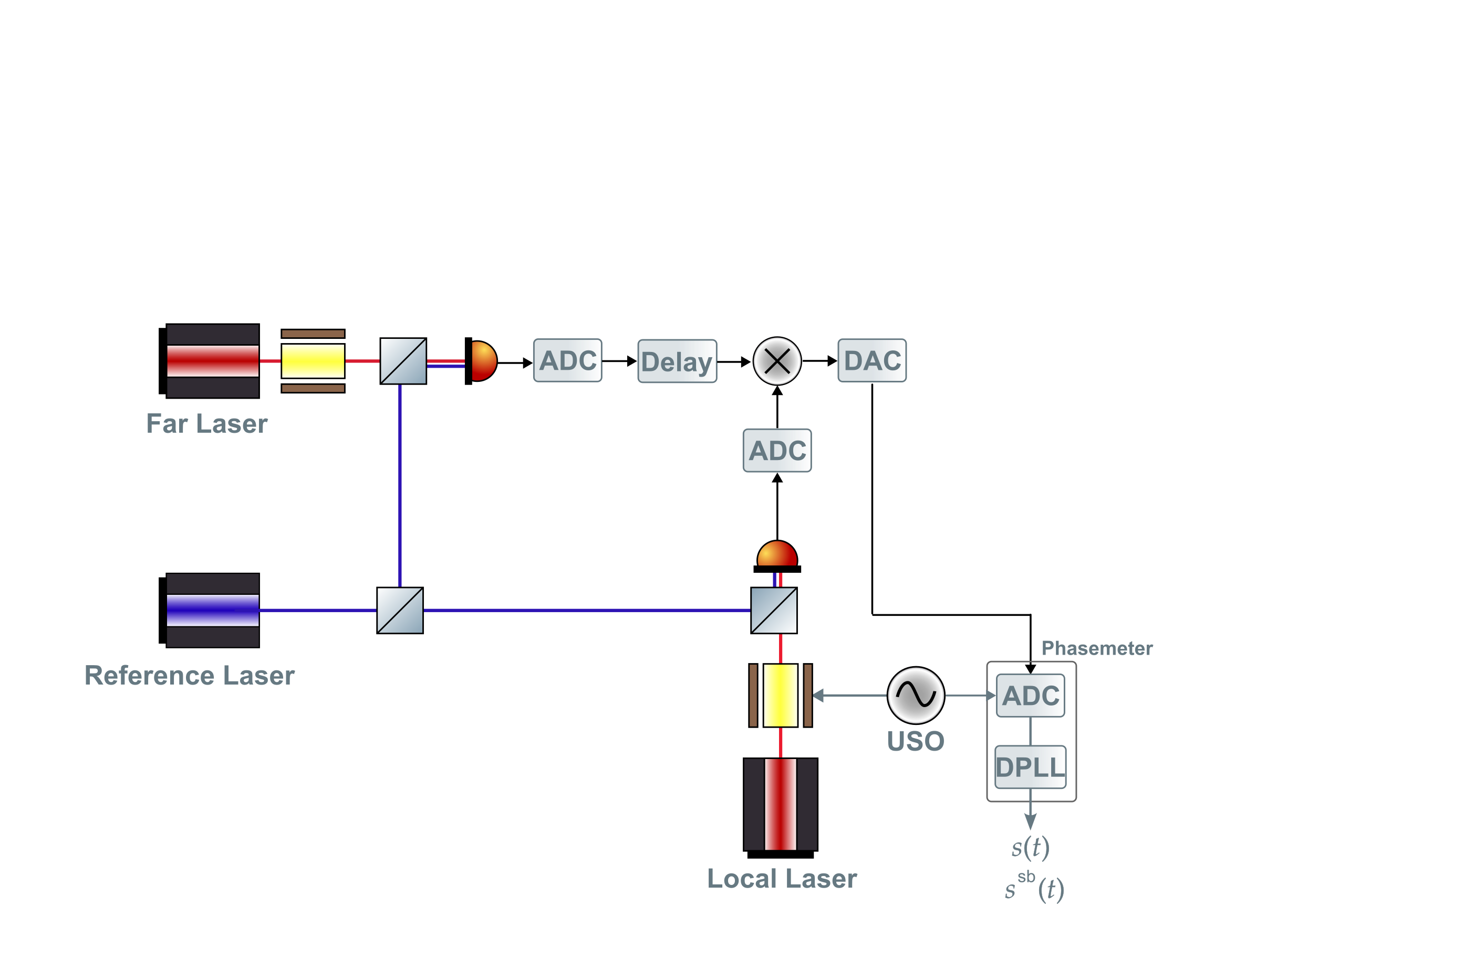
Phase Measurement with an Optical Input
Set up for generating one LISA-like science interferometer readout.
Notes:
typo

Slide 14
Phase Measurement with an Optical Input
Set up for generating one LISA-like science interferometer readout.
Sci IF
Notes:
Add the beatnotes here?

Slide 15
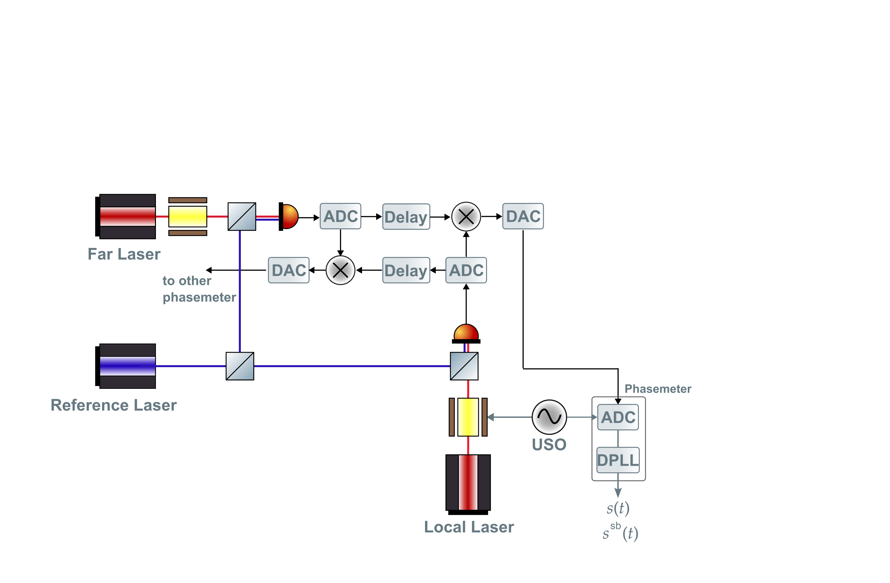
Phase Measurement with an Optical Input
Set up for generating one LISA-like arm link.
~15 MHz
~60 MHz
~10 MHz
Notes:
typo

Slide 16
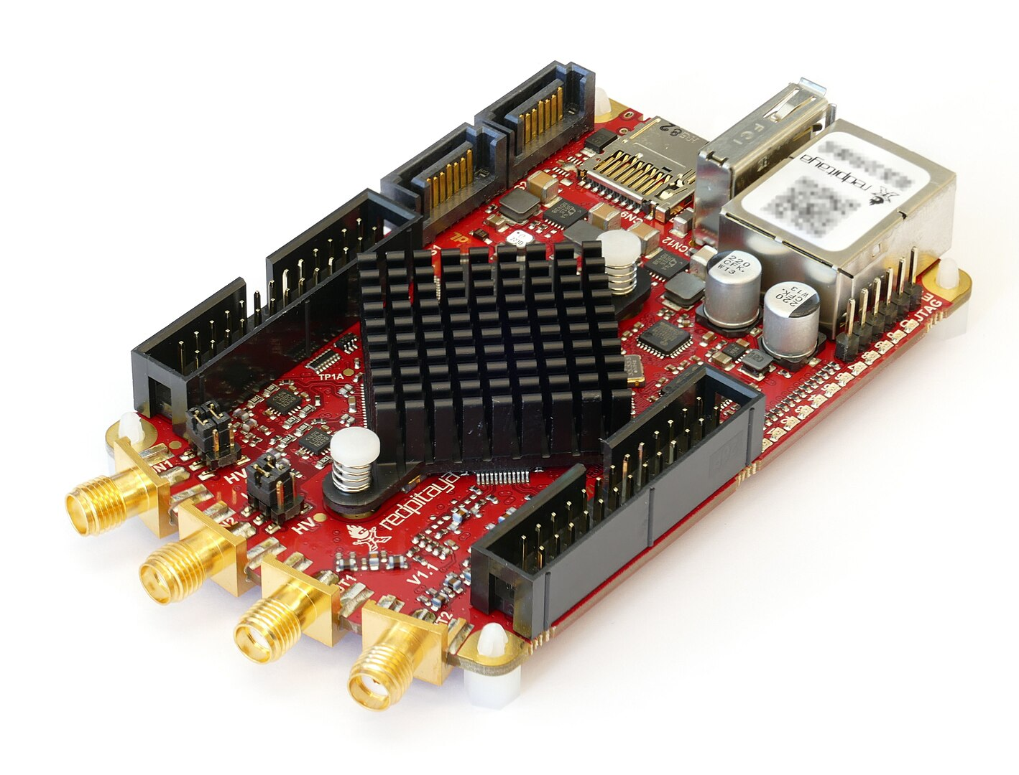
The Phasemeters
Red Pitaya running LISA gateware
Red Pitaya

Slide 17
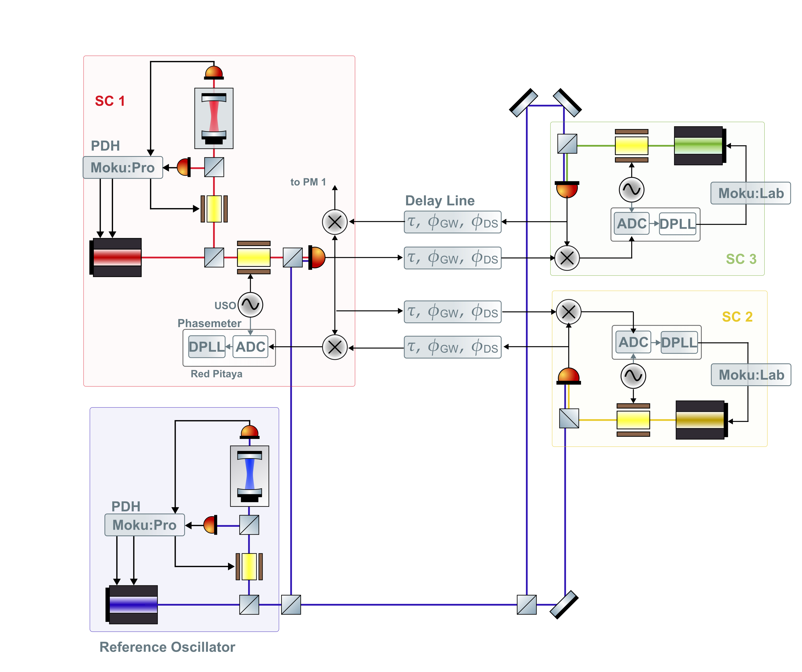
Two-arm Testbed
Notes:
Here have the reference

Slide 18
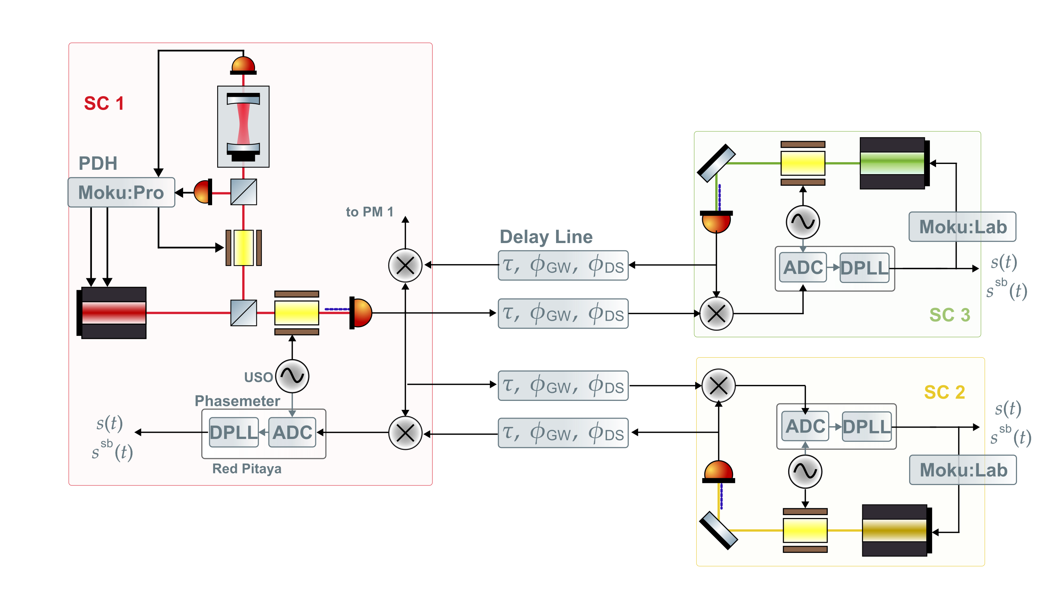
Two-arm Testbed

Slide 19
Possible Additions
More true-to-LISA clock noise transfer
Needs some more studying
Third arm link
Needs frequency planning
Test mass acceleration noise
Notes:
Firstly, the actual clock transfer system is a bit more complicated than just USO – phase modulation – read out on other SC.

Slide 20
Thank you for listening!

